Slide 1
Bootstrap
UIUC ECON 490: Applied Machine Learning in Economics

Slide 2

Bootstraps
Oldest boot dates to at least 10,000 BC

Slide 3
Parameter Distribution
==============================================================================
Dep. Variable: pos_net_jobs R-squared: 0.028
=====================================================================================
coef std err t P>|t| [0.025 0.975]
-------------------------------------------------------------------------------------
Intercept 0.3048 0.007 43.353 0.000 0.291 0.319
estabs_entry_rate 0.0276 0.001 38.454 0.000 0.026 0.029
=====================================================================================

Slide 4
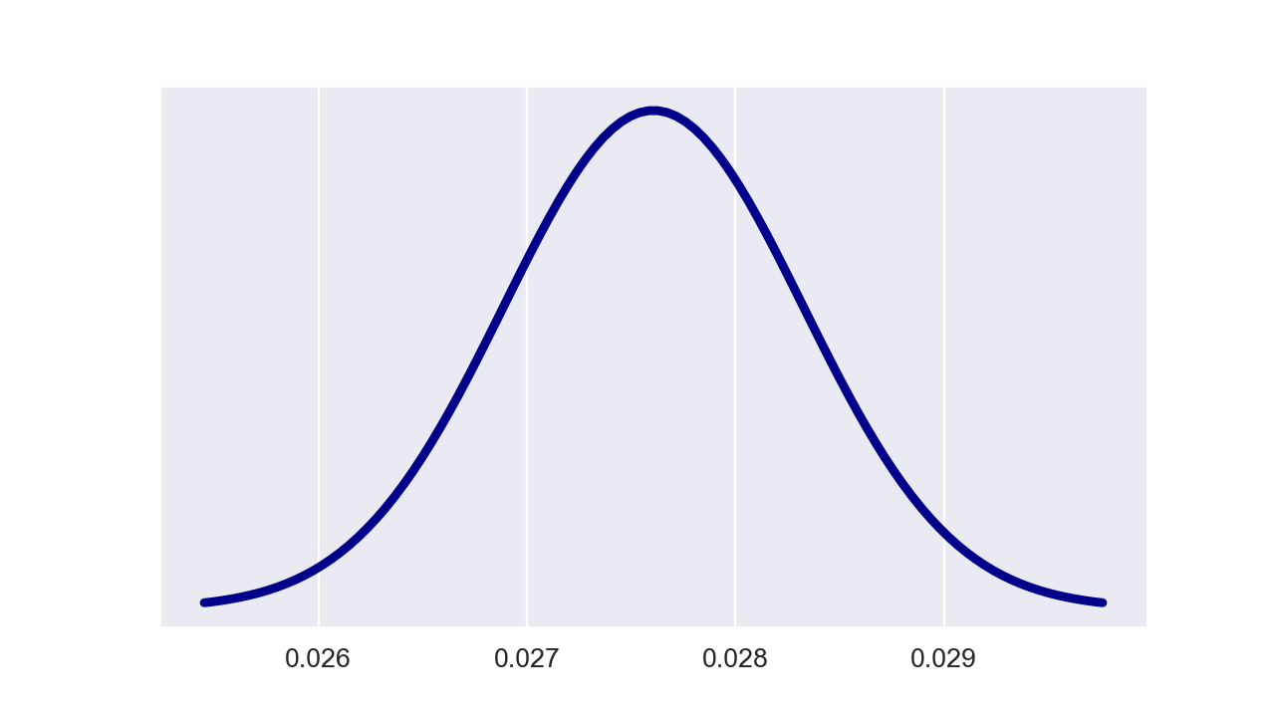

$\hat{β}=0.0276$, $SE\left(\hat{β}\right)=0.001$

Slide 5
The Bootstrap
Empirical Problems
Population of interest
Infinite
Sample from the population
Finite
Bootstrap
Sample from sample with replacement multiple times
Finite
Number of sample with replacement equal to number of rows

Slide 6
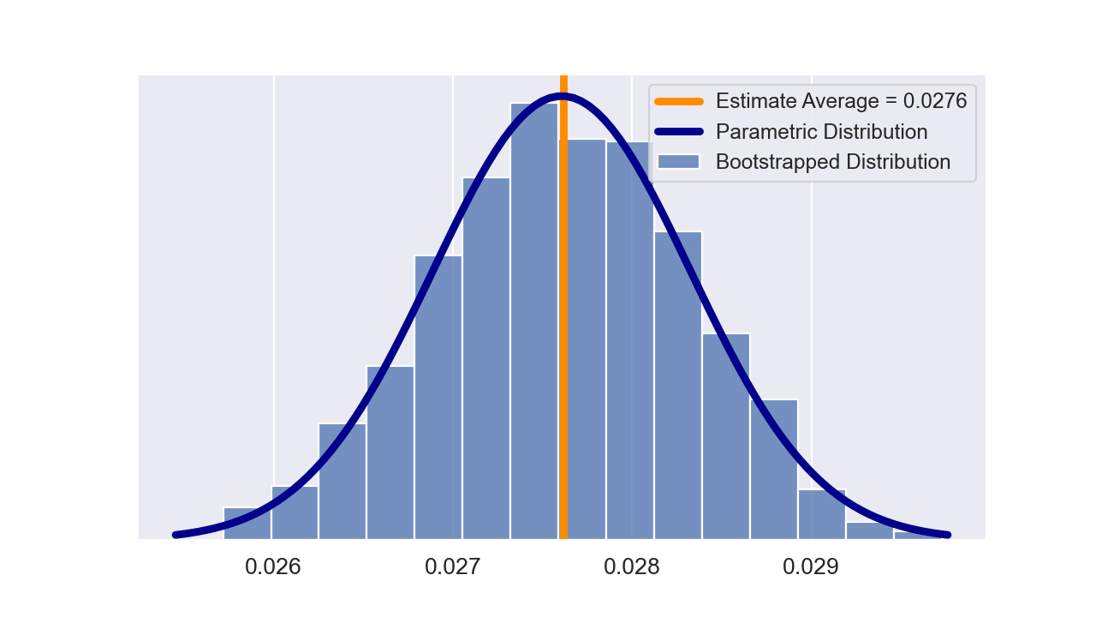
Parameter Distribution - Bootstrap

Slide 7
Nomenclature
“Pull yourself up by your bootstraps.”
Succeed on your own without help.
Normally need multiple independent samples to be confident of coefficients.
Bootstrapping acts as a proxy

